Slide 1
Unit Test Basic
Part -2
“Tests are stories we tell the next generation of programmers on a project.” ― Roy Osherove

Slide 2
Stub and Mocks
Mocks and stubs are fake Java classes that replace external dependencies.
A stub is a fake class that comes with preprogrammed return values.
A mock is a fake class that can be examined after the test is finished for its interactions with the class under test.
Typical mocks are classes with side effects that need to be examined, e.g. a class that sends emails or sends data to another external service.

Slide 3
Stubbing and Mocking with Mockito
Typically, we mock all other classes that interact with the class that we want to test. Mockito uses "mocks" for everything.
Common targets for mocking are:
Database connections,
Web services,
Classes that are slow ,
Classes with side effects and non-deterministic behavior.

Slide 4
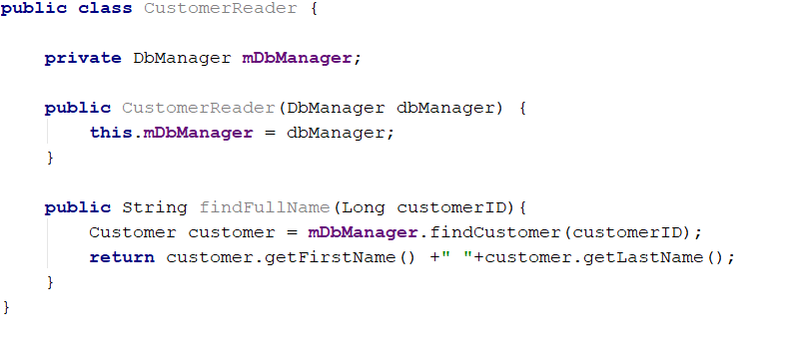
Example
we have a class that reads a customer from the database and forms their full name.

Slide 5
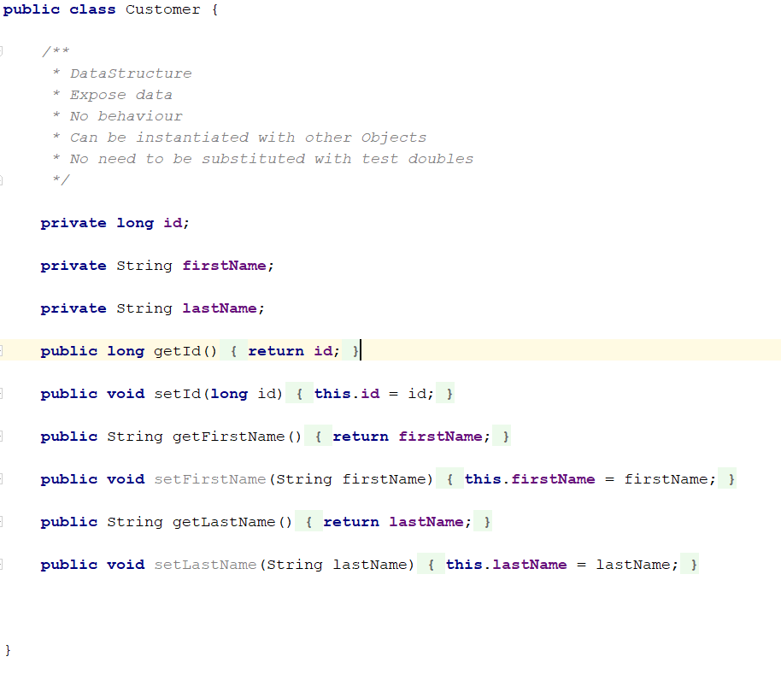
Cont..

Slide 6
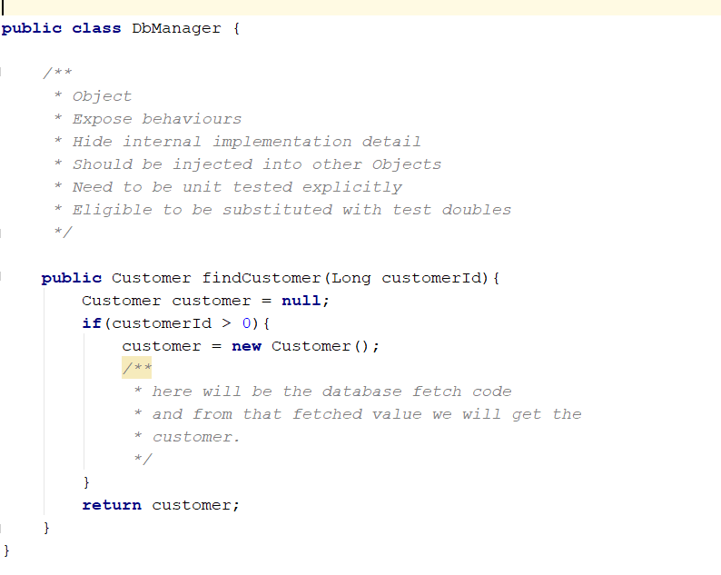
Cont..

Slide 7

How to test this best way ?
One option would be to pre-fill a real database with customers and run this test against it.
Other option would be to use an in-memory database.
Another option would be completely remove the database dependency

Slide 8
Picking up the best solution
The best solution for a true unit test is to completely remove the database dependency.
We will stub the database connection instead, and "fool" our class to think that it is talking to a real DbManager, while in reality the DbManager is a Mockito stub.
This way, we have complete control over what is returned by the database connection without having to deal with an actual database.

Slide 9
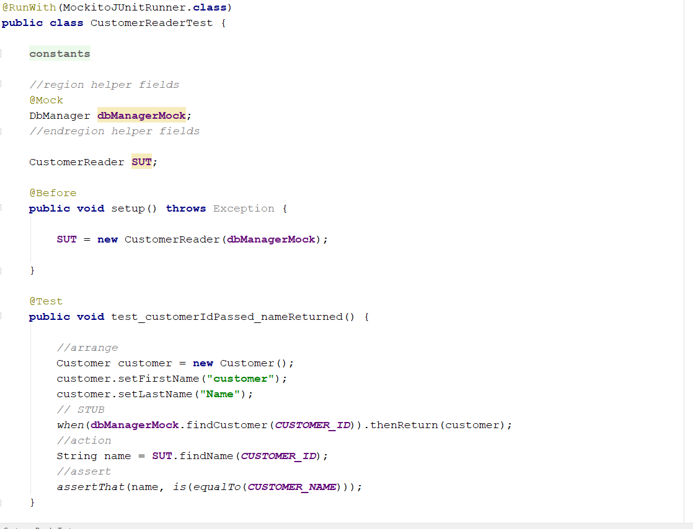
Finally the Out Come

Slide 10

Why Customer class is not mocked?

Slide 11

Object vs Data structure
https://hackernoon.com/objects-vs-data-structures-e380b962c1d2
https://www.codingblocks.net/podcast/objects-vs-data-structures/

Slide 12


